Slide 1
HTML LINKS
HTML links
Internal links
(Linking to another webpage of the same website.)
External links
(Linking to other website)
Fragment linking
(Linking different sections of the same web page.)
BOOKMARKS

Slide 2
SYNTAX
SYNTAX:
<a href="url">Link text</a>
The href attribute specifies the destination of a link.
EXAMPLE:
<a href="http://www.w3schools.com/">
Visit W3Schools </a>
NOTE: The "Link text" doesn't have to be text. It can be an image or any other HTML element.

Slide 3
TARGET ATTRIBUTE
The target attribute specifies where to open the linked document.
<a target="_blank|_self|_parent|_top|framename">
Frames and framesets are no longer supported. The _parent, _top and framename attribute values will mostly be used with iframes.

Slide 4
TARGET ATTRIBUTE VALUES
Value | Description
_blank | Opens the linked document in a new window or tab
_self | Opens the linked document in the same frame as it was clicked (this is default)
_parent | Opens the linked document in the parent frame
_top | Opens the linked document in the full body of the window
By default, links will appear as follows in all browsers:
An unvisited link is underlined and blue
A visited link is underlined and purple
An active link is underlined and red

Slide 5
TITLE ATTRIBUTE
title attribute allows an advisory title that explains the resource in more detail.
Browsers may choose different methods of showing the advisory title attribute, such as displaying the title in a tool tip or balloon help.
<a href=“http://www.yahoo.com”
title=“Yahoo website”>
Yahoo!
</a>

Slide 6

LINKING FRAGMENTS
<a name=“top”>
Welcome to world
</a>
top
Page is scrolled to the location named top
<a href=“#top”>
go to top of the page
</a>
Go to top

Slide 7
NAME ATTRIBUTE
It Allows links to be able to point to a specific section within a document .
The name attribute is used to create a bookmark inside an HTML document.
Once you have named a location in the document, you can go to that location taking a normal link tag & adding a number sign (#) & the name assigned to the URL.

Slide 8
EXTERNAL LINKS
<a href=“http://www.yahoo.com”> Yahoo! </a>
Anchor element’s href attribute is used to specify the Hyperlink Reference (that is, a reference to link’s address).
When linking to an external document, it is essential to provide http:// otherwise the link will not work.

Slide 9
INTERNAL LINKS
<a href=“file.html”> Go to next page</a>
In href , specify the relative path of the document to which you want to link.

Slide 10
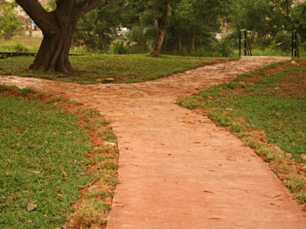
Internal Linking: understanding paths
There are two types of pathnames: 1. Relative path.
2. Absolute path.
Notes:
Always try to use relative paths for your links. By doing so, even if you move your document or files to another computer, the link will still work.

Slide 11

Absolute path →specifies a file’s precise location within a computer’s entire folder structure.
C:/course/html/intro.html
course
Ms-office
html
index.html
class1
list.html
intro.html
chem.html
math.html
eng.html
Notes:
Always try to use relative paths for your links. By doing so, even if you move your document or files to another computer, the link will still work.

Slide 12
Absolute path →specifies a file’s precise location within a computer’s entire folder structure.
C:/course/html/class1/eng.html
course
Msoffice
html
index.html
class1
list.html
intro.html
chem.html
math.html
eng.html
Notes:
Always try to use relative paths for your links. By doing so, even if you move your document or files to another computer, the link will still work.

Slide 13
Relative path →specifies a file’s location in relation to the location of the current document.
course
Ms-office
html
index.html
class1
list.html
intro.html
chem.html
math.html
eng.html
Notes:
Always try to use relative paths for your links. By doing so, even if you move your document or files to another computer, the link will still work.

Slide 14
If the file is in same folder as the current document, you do not specify the folder name.
contact.html
course
Ms-office
html
index.html
class1
list.html
intro.html
contact.html
chem.html
math.html
eng.html
Notes:
Always try to use relative paths for your links. By doing so, even if you move your document or files to another computer, the link will still work.

Slide 15
If the file is in a subfolder of the current document, include the name of the subfolder followed by the file name.
class1/math.html
course
Ms-office
html
index.html
class1
list.html
intro.html
contact.html
chem.html
math.html
eng.html
Notes:
Always try to use relative paths for your links. By doing so, even if you move your document or files to another computer, the link will still work.

Slide 16
HTML IMAGES
In HTML, images are defined with the <img> tag.
The <img> tag is empty, which means that it contains attributes only, and has no closing tag.
Syntax:
<img src="url" alt="some_text"/>

Slide 17
ATTRIBUTES OF <IMG/> TAG:
SRC (tells the browser where the image is located.)
HEIGHT (in numbers)
WIDTH (in %)
BORDER (in numbers)
BORDER color (black by default)
(style="border-color:green“)
TITLE( specifies a text title. The browser, perhaps flashing the title when the mouse passes over the link)
ALT(text description for browsers that have images turned off or the text that is displayed if the image isn't displayed for some reason)
ALIGN(left right center)
Hspace (horizontal space in % or in num)
Vspace (vertical space in % or in num)

Slide 18
ALT ATTRIBUTE
The required alt attribute specifies an alternate text for an image, if the image cannot be displayed.
E.g:
<img src="boat.gif" alt="Big Boat" />

Slide 19
ALLIGN ATTRIBUTE
Choosing align=“left” or align=“right” causes the image to be placed directly against the left or right margin.
Text after the <img /> element will flow around the image.
E.g:
<img src=“spider.gif” align=“right”/>

Slide 20
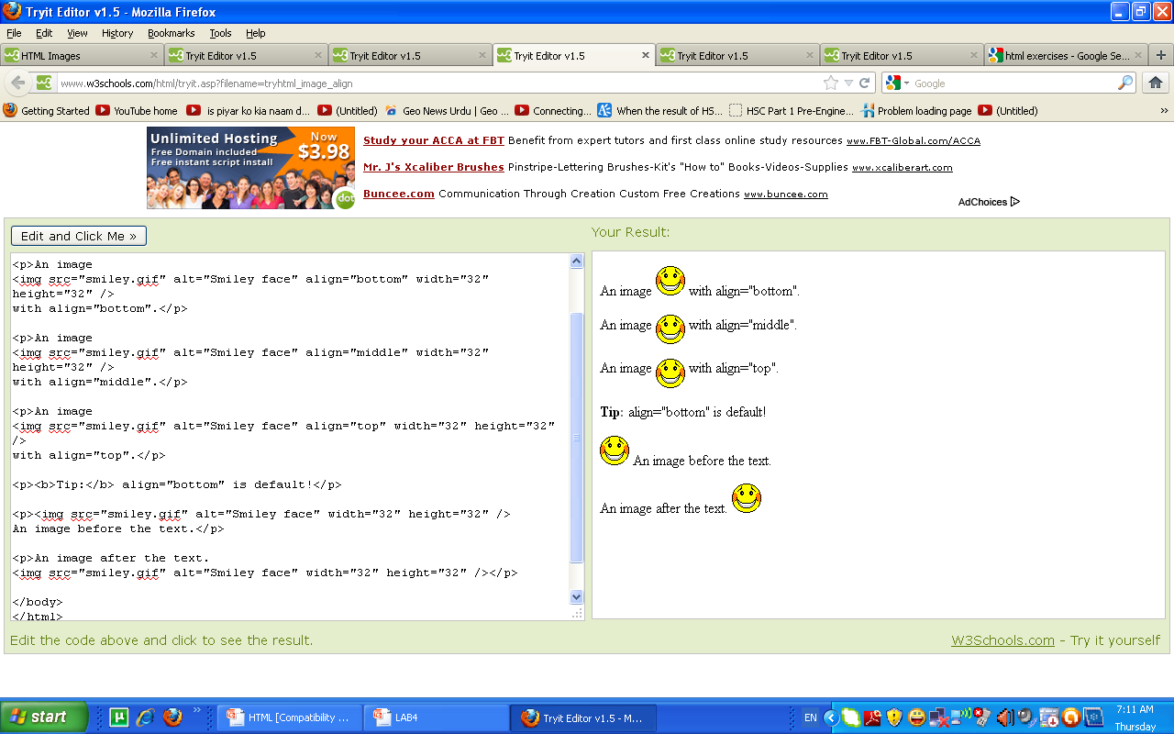
ALLIGN IMAGES

Slide 21
ADDING WHITE SPACE
The vspace attribute sets the no. of pixels of vertical white space around the image (both top & bottom).
The hspace attribute sets the no. of pixels of horizontal white space around the image (both left & right).
E.g:
<img src=“spider.gif” hspace=“20” vspace=“20”/>

Slide 22
IMAGE AS A LINK
Image can also be used as links.
<a href=“url”>
<img src=“url” />
</a>

